Slide 1

Dual Data Cache

Slide 2
Abstract:
The Scalar Processors have a performance setback when it comes to Vector(Array) processing and other vector applications because of the Scalar processors limitation of processing single instruction at a time.
The remedy to such trade-off is a data cache organisation system called Dual Data Cache.
The Dual Data Caching technique implement lazy caching technique.

Slide 3
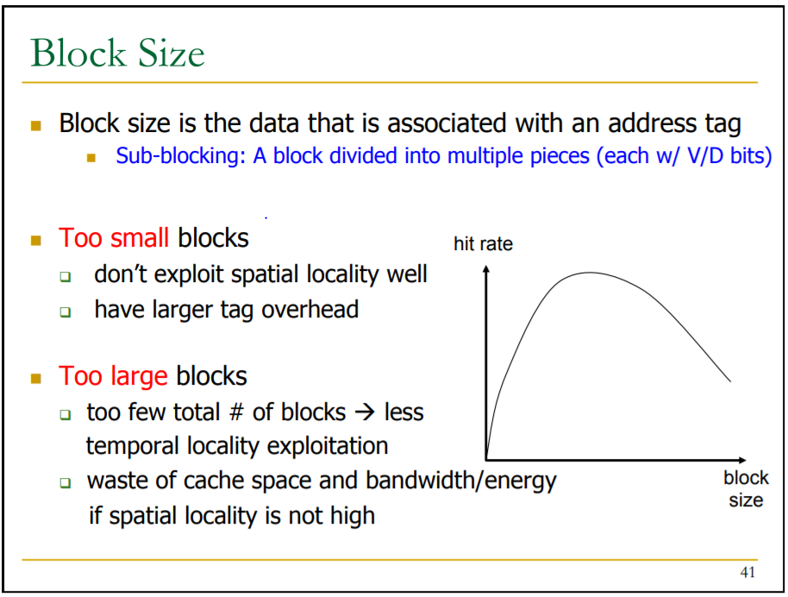
Reference from Lecture Class

Slide 4
Why this topic caught out Intrigue?
Caching is one of the most vital and fundamental concept of Computer Science.
Are the current caching technologies ready to handle emerging communication capabilities?
As a matter of fact it is expected that video traffic will encompass 80% of the net internet traffic.
Apart from this the proliferation of online social networks (OSNs) is placing users in the role of content creator, and disrupting the traditional server-user client model.
To contribute our part and attempt to learn something new about the working and implementation of Spatial and Temporal caches and work out the existing trade-off using Dual Data Caching Technique.

Slide 5
Basic Functionality:
The Dual scheme is the first study that exploits temporal and spatial localities in two separate organizations.
Temporal cache can only exploit the temporal locality whereas the spatial cache can exploit both kinds of localities.
The scheme processes line classification at runtime using a large hardware history table to predict the expected data-locality type.

Slide 6
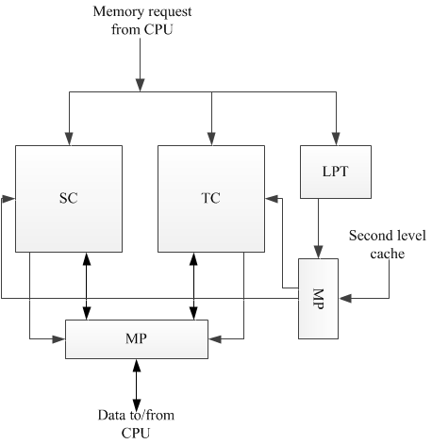
Block Diagram of Dual Data Cache:

Slide 7
LPT(Locality Prediction Table) :
A key part of the Dual Data Cache is the scheme that decides in which subcache each reference is placed.
The LPT is based on capturing the stride exhibited by memory instructions.
Instructions with zero stride (e.g., scalar references) and instructions with strides larger than the Spatial Cache line size that do not interfere with themselves when placed in the Temporal Cache.

Slide 8
How LPT is used?
If the required data is only in one of the subcaches, the data is read or written in that subcache. This is a cache hit.
If the required data is found in both subcaches, it is read from any of them or written into both two. This is again a cache hit.
If the required data is not in any subcache, a cache miss occurs.
The predicted locality for a memory reference is based on guessing whether the accessed data is an scalar, or an element of a vector, and in the case of being a vector element, it also depends on the stride and the size of the vector.

Slide 9
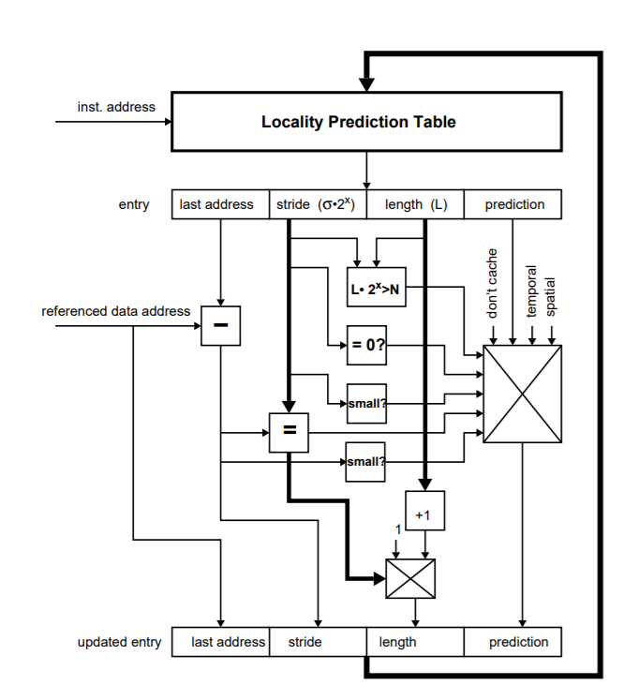
Hardware to implement the Locality Prediction Table :

Slide 10
Performance Evaluation:
Comp: The Unix compress utility. It is one of the SPEC CINT92 benchmarks.
If: A do-loop with conditional statements that alternates different strides for accessing a vector.
Mm: A matrix by matrix multiplication.
Bmm: This is a blocked version of a matrix by matrix multiply that in addition makes use of copying.
Spmv: Sparse matrix by vector.
Tri: A triangular matrix by matrix multiplication.

Slide 11
Conclusions:
A novel data cache design for (super)scalar processors has been presented.
In other words, the proposed scheme is away of having large lines, which are convenient to exploit spatial locality, and small lines.
The performance figures obtained for a set of benchmarks show that the dual data cache out performs a conventional cache.
However, even for non-vector codes, the dual data cache improves the performance of a conventional cache.
For instance, in the case of matrix multiply with blocking and copying, the average access time of the dual cache was still 2% lower than that of a conventional cache.

Slide 12
Sources:
Multiple Caching Strategies Tuned to Different Types of Locality:
https://drive.google.com/open?id=1D5kcfvF9_j8YwG7xhwFdiyxPygicBsYt
From this we started to follow these three research papers:
The Dual Data Cache: Improving Vector Caching in Scalar Processors –https://drive.google.com/open?id=1w1gFqtEQpTxXJVPUV4HvcZAXHNOmS8zR

Slide 13
Load instruction steering in a dual data cache microarchitecture - US5898852A
Inventor
Joseph Anthony Petolino, Jr.
William Lee Lynch
Gary Raymond Lauterbach
Kalon S. Holdbrook
https://patents.google.com/patent/US5898852A/en
Splitting the Data Cache: A Survey - https://drive.google.com/open?id=1MUBnOyJCdPYpOuhVl-yBh3wXFF5GN9dB

Slide 14

THANKYOU

